Slide 1
The impact of the environment on asthma development and pathophysiology
Developed in collaboration with Professor Harald Renz

Slide 2
The integrated function of the epithelial structure
There is a constant ongoing battle on the surface of the epithelium due to exposures to particulates, microbes, viruses, bacteria, fungi, parasites, etc.¹
The epithelium responds to damage triggered by the environment²
Climate change has direct and indirect effects on the epithelial barrier of humans due to:³
Extreme heat events
Increased humidity
Increased allergens
Increased air pollution, including sand and dust storms and wild fires
Mucus
DC
Smoke/ pollutants
Neutrophil
DC
ILC1
Mast cell
Viruses
IgE
TSLP/ IL-25/ IL-33
Eos
Triggers
Allergens
ILC2
Mast cells
Fungi
TSLP
Macrophage
Bacteria
TSLP/ IL-33
Neutrophil
DC

Slide 3
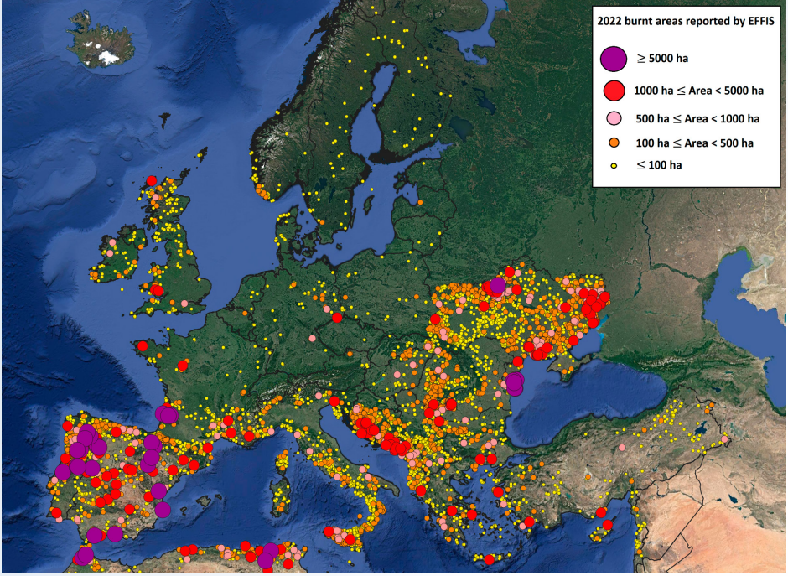
2022: Second largest burnt area on record across the EU countries
The figure shows one of the warmest summers on record, however, we know that each year since then the temperatures have progressively increased.^{1,2} We have experienced a record loss of glaciers, record number of wildfires, etc.³
Climate change leads to an increasing pressure on the epithelial barrier, which must respond to these increases in exposures⁴
Distribution and extent of burnt areas across Europe and the Mediterranean in 2022¹

Slide 4


Wildfires and their effects on the immune system, other organs and foetus
The increasing number of wildfires comes with associated pollutants, e.g., carbon dioxide, carbon monoxide, hydrogen cyanide, etc. Smoke-associated particles travel thousands of kilometres and impact the health of people who live even a great distance from the incidents
Immune system
• Reduced function
• ↑ Infection risk
• ↑ Inflammation
• ↑ Oxidative stress
• Activation of TLRs and inflammasome
• Epigenetic changes
Central nervous system
• Oxidative stress
• ↑ Inflammation
• ↑ Early Alzheimer’s disease
• ↑ Mental health issues
• Cognitive defects
• ↑ PTSD
• ↑ Stroke
Pollutants greatly impact the airway epithelium, leading to:
Wildfire-associated pollutants:
Aldehydes, carbon monoxide, hydrogen cyanide, VOCs, CO₂, SO₂, toxic metals, particulate matter, PAHs, ozone,
organic acids, nitric oxide, microplastics
Increasing inflammation
Activation of Toll-like receptors
Barrier damage
Lung damage
Underlying cellular and molecular mechanisms
Foetus development
• Asthma in later life
• Lung damage
• Cognitive defects
• ↑ Maternal glucose
• ↑ Male birth weight
• Epigenetic changes
Gastrointestinal system
• ↑ Inflammation
• Epithelial barrier damage
Airways
• ↑ Inflammation
• TLR activation
• Epithelial barrier damage
• Lung damage
• ↑ Autophagy
• T-cell death
• ↑ Fibrosis
Skin
• ↑ Inflammation
• Rash, irritation
• Burns
• Epithelial barrier damage
Cardiovascular system
• ↑ Inflammation
• ↑ Heart attack
• ↑ Hypertension
• ↑ Thromboembolism

Slide 5
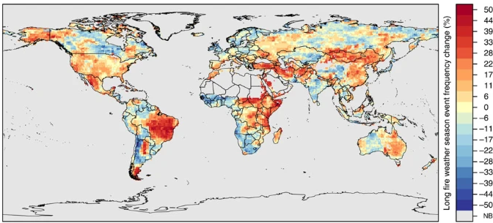
Climate changes in long fire weather season 1979–2013
Wildfires are not a localised issue but rather a global issue
Some regions have a fire season frequency increasing by over 50%

Slide 6
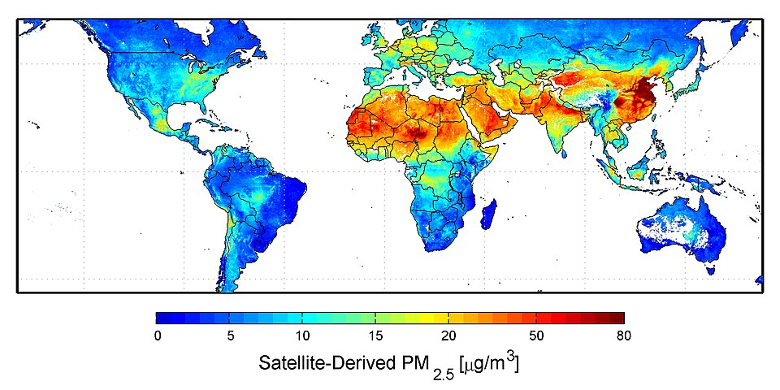
Worldwide PM_{2.5} air pollution (2016: from satellite images)
Fine particulate matter, together with wildfires and industrialisation, have contributed to a global increase in air pollution^{1,2}
Satellite images show us a dramatic increase in PM_{2.5} exposure over the last 2 decades^{3,4}

Slide 7
Changes in annual pollen load and pollen season duration
Warmer temperatures, particularly rising minimum temperatures, are strongly associated with:¹
In some parts of the world, patients no longer have any pollen-free air exposure; this has a direct and immediate impact on the epithelial barrier^{1,2}
E.g., in Europe ragweed pollen counts have increased over time, and by 2050 are predicted to be 4 times higher than they were in 2015³
Increased pollen production
Longer pollen seasons

Slide 8
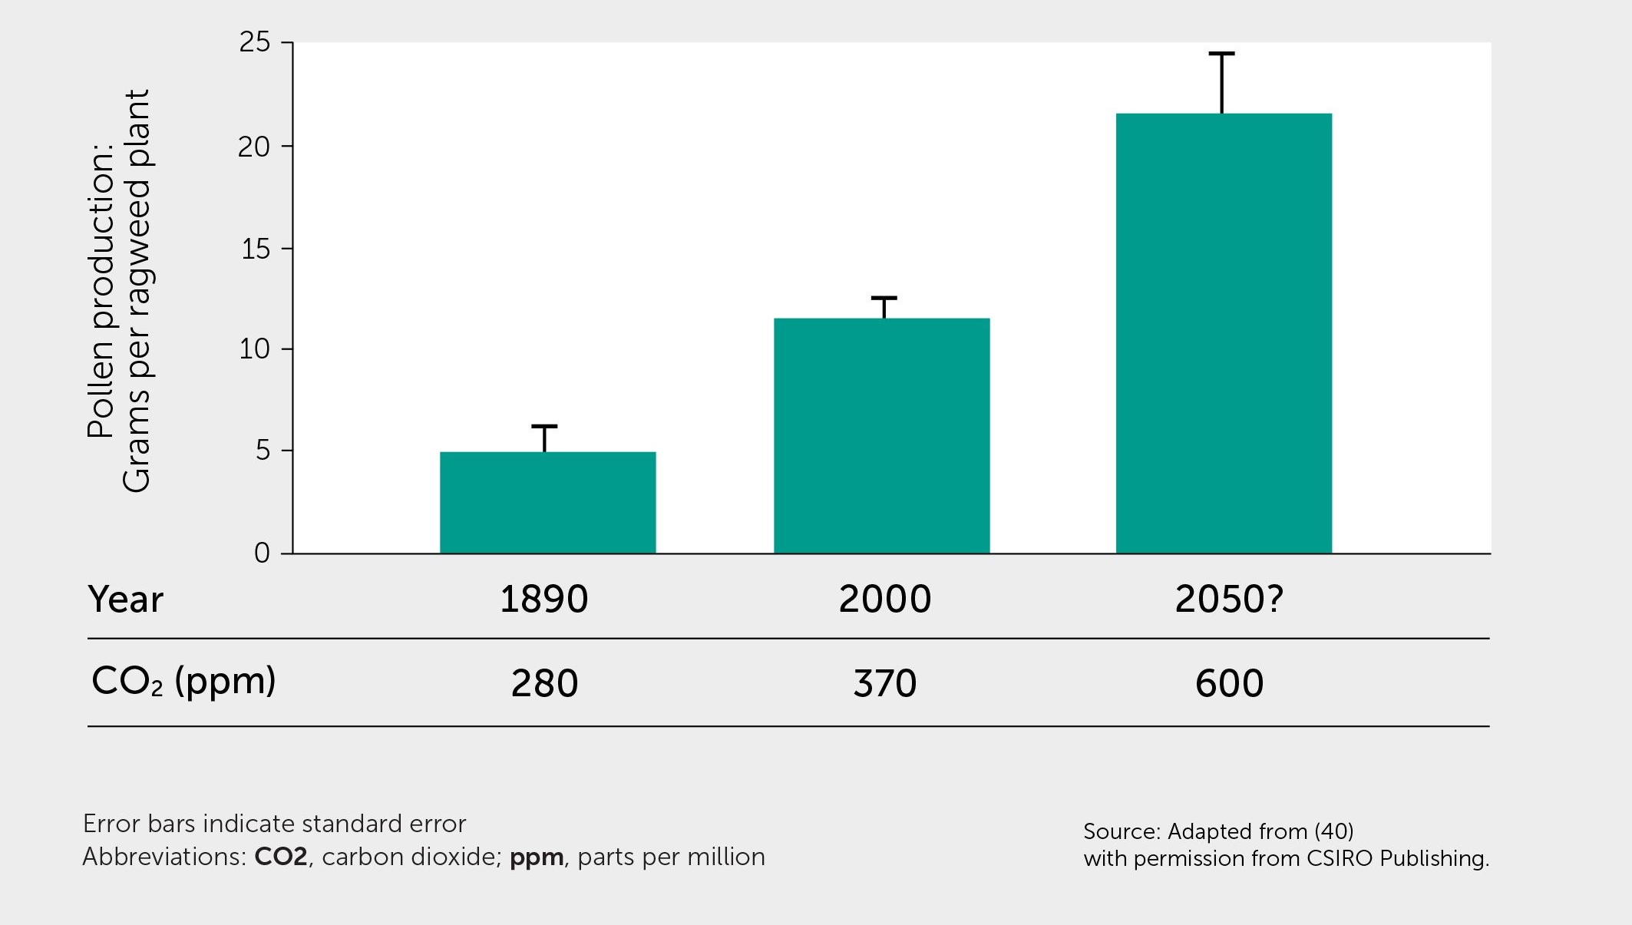
Pollen production is linked to atmospheric CO₂
Pollen concentrations rise with increases in atmospheric carbon dioxide
Pollen production in common ragweed grown at pre-industrial CO₂ concentrations (280 ppm), current concentrations (370 ppm) and a projected 21st century concentration (600 ppm)ª

Slide 9
Elevated CO₂ level: Ragweed pollen with higher allergenicity
The plant transcriptome changes in response to increasing temperatures and carbon dioxide levels, which causes the pollen to develop a higher degree of allergenicity^{1,2}
In response to this, the epithelial barrier changes its epigenetic programming through modification of genetic expression, without altering the DNA sequence, leading to changes in allergic sensitisation³
Ragweed pollen grown under elevated CO₂ levels elicits stronger allergic lung inflammation¹
Epithelial cells
In vitro tests and in vivo mouse allergy model
Pollen metabolome analysis
TNF, IL-1β, IL-6, IL-8
DC
Eos
ILC2
TNF, IL-1β
Neutrophil
DC
DC
IL-1β
IL-10
TNF
IL-10
IgE
Increased pro-inflammatory pollen metabolites
Increased allergic inflammation

Slide 10
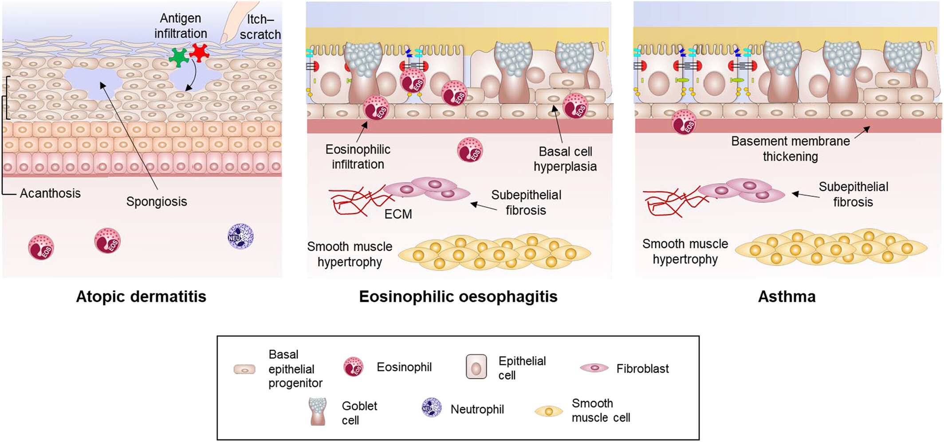
Activation of cellular and molecular pathways by climate change events
Definition of event-triggered cellular and molecular pathways is in its infancy
E.g., extreme heat, toxins, wildfires, increased exposures to pollutants, allergens, dust, etc.¹
Cellular and molecular pathways in different organs overlap, which may contribute to the similar inflammatory responses throughout the body¹
Multiple particles and soluble triggers integrate within the inflammasome of epithelial cells and stimulate the synergistic pathways¹
Epithelial disruption in atopic dermatitis, eosinophilic oesophagitis and asthma²
Climate change triggers events such as wildfires, sandstorms and extreme heatwaves, and increases exposure to dust and aeroallergens. These affect the integrity and function of the epithelial barrier in the skin, lung and gut¹
This results in exacerbation of chronic inflammatory conditions in the upper and lower airways, such as asthma¹

Slide 11
Major effects of climate change with an impact on immunity and inflammation^{1,2}
Extreme heatwaves¹
Air pollutants (e.g., PM, O₃, CO₂) and wildfires, dust and sandstorms^{1,2}
Pollen exposure
(counts, pollen season, allergenicity)¹
Reduced biodiversity¹
Obesity (common driver for global warming and metabolic syndrome)¹
Epithelial barrier: leaky gut syndrome
Epithelial barrier: ROS-production, NFkb-activation, IL-1, NLRP3-inflammasome, CXCL8
Epithelial barrier: TSLP, IL-33 and IL-25
Immunity: reduced tolerance and adaptive immunity
Immunity: chronic and adipo-inflammation
Immunity: Endotoxin-triggered inflammation, decreases adaptive immunity
Immunity: inflammation instructing type 2 responses (eosinophils, mast cells), decreasing Th2 inflammation
Clinical outcomes: chronic inflammatory disease with metabolic dysregulation (allergies, autoimmunities). Metabolic disease with chronic inflammation (e.g., diabetes, cardiovascular disease)
Immunity: activation of neutrophils, macrophages and other innate immune cells, T-cell suppression and decreasing adaptive immunity
Clinical outcomes: toxic shock and organ failure
Clinical outcomes: asthma, allergic rhinitis, conjunctivitis and sinusitis
Clinical outcomes: chronic inflammatory lung disease (new onset, worsening of existing disease including COPD, asthma, rhinosinusitis)

Slide 12
Hygiene hypothesis
Immune protection is strongly associated with multiple environmental factors (e.g., diet, dust, animals, family members…) that have a high diversity of environmental microbes^{1,3}
Some environmental microbes are beneficial⁴
Commensal bacteria can play a role in defence against infectious respiratory pathogens through inducing an immune response in the host
The probability of asthma declines with increased microbial diversity
The hygiene hypothesis describes the protective influence of microbial exposures in early life on the development of allergy and asthma^{1,2}

Slide 13
Biodiversity hypothesis
Microbial diversity is a key factor in regulating immune responses¹
Some environmental microbes are beneficial²
Early exposure to a diverse range of ‘friendly’ microbes trains the immune system to respond properly to stimuli^{1,3}
Global increase in chronic immune diseases is related to decline in biodiversity and a lack of immune training⁴
The epithelial barrier is directly related to the biodiversity hypothesis; however, we need to better understand the role and contribution of it^{1,3,4}

Slide 14
How do environmental bacteria regulate the mucosal–microbial–immune interface?
Ege MJ, et al. 2008¹¹
Ege MJ, et al. 2008¹²
Conrad ML, et al. 2009¹
Blümer N, et al. 2007²
Blümer N, et al. 2005³
Epithelial barrier function
Renz H, et al. 2011⁹
Renz H, et al. 2021¹⁰
Activation
Clinical manifestations of upper and lower airway diseases ​ are driven by heterogenous and overlapping inflammatory ​ pathways initiated at the epithelium^{1–10}​
Kirjavainen PV, et al. 2019⁷
Depner M, et al. 2020⁸
Braun-Fahrländer C, et al. 2002⁴
PAMPs PRRs
Environmental bacteria
Competition for space
Innate and adaptive immune function
Host microbes
Activation; polarisation of immune response
Altered composition
Brand S, et al. JACI 2011⁵
Alashkar Alhamwe B, et al. 2023⁶

Slide 15



Repeated intranasal administration of Acinetobacter lwoffii
A. lwoffii can protect patients from developing asthma as repeated intranasal administration of the bacteria drives chronic, subclinical, IL-6-induced inflammation, which:
Triggers tolerogenic IL-10 production in T cells
Depends on a unique epigenetic map
A. lwoffii exposure prevents asthma development, and this protective effect requires IL-6 and IL-10
IL-6 deficiency alters gut microbiome, and A. lwoffii exposure restores the microbial balance
A. lwoffii alters histone modifications in T cells

Slide 16
Summary
Many environmental factors affect epithelial-driven disease, for example:
Increasing wildfires come with associated pollutants (e.g., carbon dioxide, carbon monoxide, hydrogen cyanide, etc.), which can impact people’s lives even from a great distance¹
Increased pollen count for a longer duration directly correlates with increased temperature²
The environment can impact cellular and molecular pathways³
This impact causes increased inflammation, and activation of Toll-like receptors and epithelial barrier and lung function
Exposure to pollutants, allergens and extreme heat is leading to the epithelial barrier changing its epigenetic programming, starting to delineate cellular and molecular pathways
Bacteria and biodiversity also play a role in epithelial barrier dysfunction⁴
To respond appropriately to stimuli, we must understand the contribution of early exposure to a diverse range of microbes

